Slide 1
Module 4 Data Science Project: Predicting All-NBA Team Selections
David Goldstein
dgoldstein24@gmail.com
dg2996@columbia.edu

Slide 2
Hypotheses: Prompt
• The All-NBA First ,Second, and Third teams contain the best players in the NBA for a given season.
• Sports writers select the recipients of these honors
• Questions that follow:
- Do the selections reflect the best players statistically or are there other factors/biases?
> If not, then the NBA Collective Bargaining Agreement may be inherently flawed
*NBA players are eligible for ”SuperMax” contracts only if they are selected to All-
NBA teams
- Can future All-NBA players be predicted from their stats from the previous season?
> If so, then such a predictive model could be used to identify players poised for a breakout
season, which would be very helpful to General Mangers of NBA teams

Slide 3
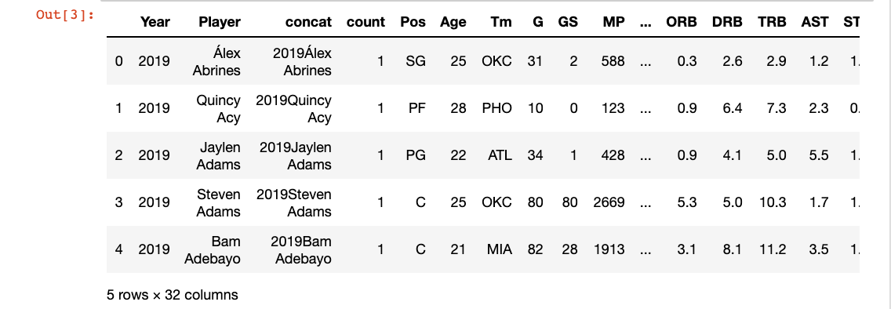
Obtain and Scrub: Compile data and clean from Basketball Reference and NBA

Slide 4
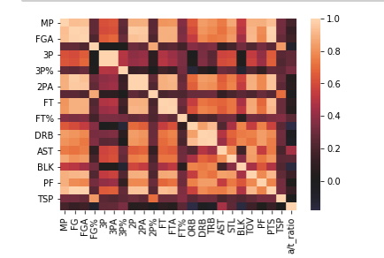
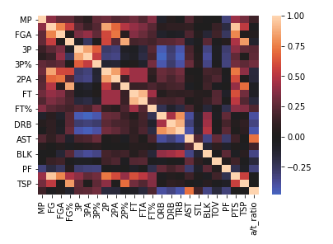
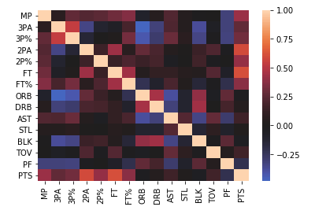
Explore: Multicollinearity graphs for overlapping features
Adjustment of stats to per 36 minutes – totals correlated to strongly with amount of minutes played
Removal of overlapping features

Slide 5
Model Pt. 1: Calculate prediction accuracy of a year’s All-NBA selection based on statistics from that NBA season
Many combinations of models and features tried to increase model accuracy and increase the interpretive meaning of the results:
• With/without minutes played as a feature
• With/without manually generated advanced statistics
- True Shooting Percentage – accounts for player’s shooting efficiency based on free throws, 2-point field goals, and 3-point field goals
- Assist to turnover ratio – Measurement of ability to create successful offensive plays while
maintaining ball security
• Simple machine learning models vs. grid search models for best-tuned ML models
• SVM vs. Adaboost vs. Random Forest
• Machine Learning vs. Connected Neural Networks
• Connected Neural Networks with varying layers, regularizations, loss functions, and activation functions

Slide 6
Validation and Next Steps
• Some interesting findings
- Discrepancy between which All-NBA team a player should have made
vs. the honor they received
> i.e. the model says Joel Embiid should have been 1st team All NBA in 2019
> I and many NBA thought leaders agree
• The most accurate ML and CNN models both had an accuracy of about 97.8%
- Inference: All-NBA selections are primarily determined from current season statistics
- Inference: findings may have been skewed by the ratio of selected players to all players in the
database being too small: the model could be accurate by predicting every player to not be All-NBA
• A more interesting exploration would be predicting players to make All-NBA next year based on this year’s statistics
- More actionable information for GM’s
- Likely less direct correlation (and therefore more for the model to have to do) as compared to
relationship between current season stats and current season All-NBA
- Additional thoughts – Filter players by the number of minutes played to increase the ratio of
selected players to total players evaluated by the model & remove 1st, 2nd, 3rd team differentiation

Slide 7
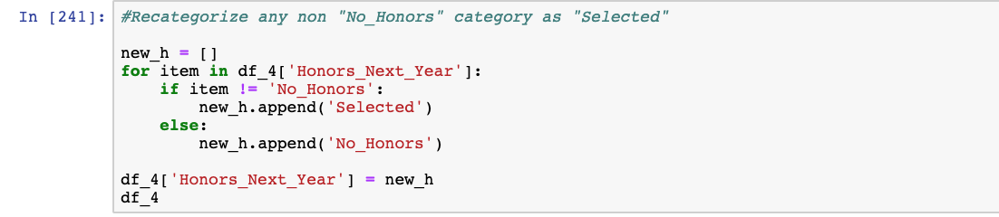
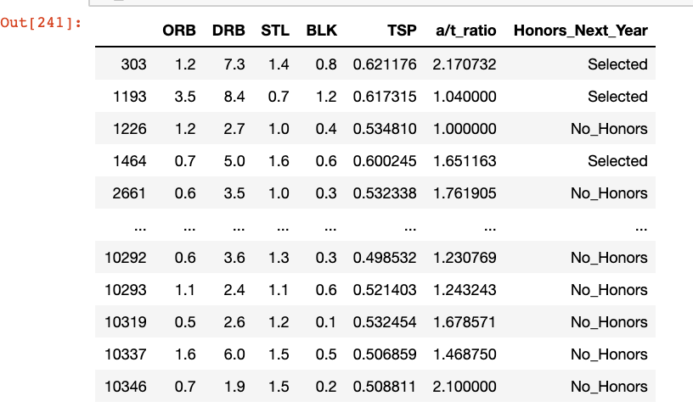
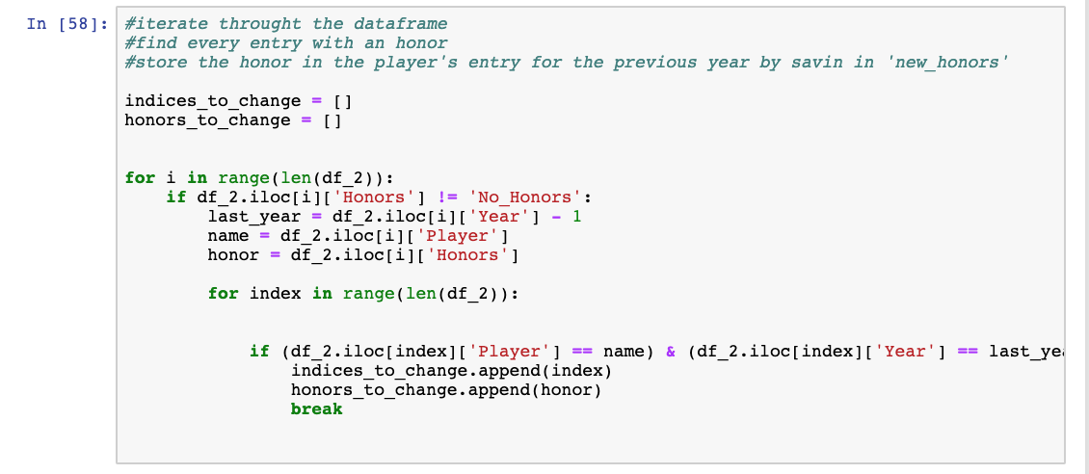
Obtain and Scrub: Shift player selections back a year, simplify labels to selected vs. non-selected, and filter by min played

Slide 8
Model Pt. 2: Calculate prediction accuracy of next year’s All-NBA selection based on statistics from current NBA season
• Run through combinations of models and tuning parameters similar to part 1 in order to find the most accurate prediction model
• Best model: Machine learning model: Grid Search-tuned Random Forest Classifier
- 79.48% accuracy
- Not every guess was No Honors – improvement over issue with part one

Slide 9
Validation and Results
• In this case, the evidence of true positives and no glaring false positives is more important than false negatives - it is more important to find diamonds in the rough than to scrutinize over every option you might have missed
• The model did not have any glaring misses in terms of predictions – no players who were False Positives were far away from All-NBA consideration
• The below players were correctly predicted to be All-NBA players based on their stats the previous year, even though they had not made All-NBA in that previous year
- By continuing to build on the model, this analysis could be a useful tool to identify players
poised for breakout seasons
Karl-Anthony Towns 2017 -> 2018
James Harden
2016 -> 2017
Blake Griffin
2011 -> 2012
Dwight Howard
2006 -> 2007
Paul Pierce
2001 -> 2002

Slide 10
Interpret: Recommendations
Rec 1: Trust that All-NBA teams are an accurate reflection of statistical excellence
Rec 2: Do not try to predict future All-NBA appearances of players who have played very few minutes
Rec 3: Utilize predictive modeling to find breakout candidates, and continue to develop the model to increase usage in this capacity

Slide 11
Interpret: Project Takeaways
ML and CNN are both very useful, CNN probably better for big, differentiated datasets. ML worked better for this project
Tuning for both ML and CNN is essential
Feature engineering based on domain expertise can drastically improve results
Predictive modeling has meaningful real-world applications in professional sports

Slide 12
Thank You
David Goldstein

